Slide 1
Maternal Health Risk Classification with Logistic Regression Algorithm and LORENS Algorithm
Advanced Data Analysis
Lecturer : Prof. Dr.rer.pol. Heri Kuswanto, M.Si.
Veronika Kolo (6003221014)
Khalifah Nadya Reihanah (6003222005)

Slide 2
Variables and Data Description
The data used is maternal health risk classification based on the physical condition of the pregnant women. Data sourced from Kaggle (https://www.kaggle.com/datasets/csafrit2/maternal-health-risk-data). The data consists of 6 predictor variables (with numeric data type) and 1 response variable (with categorical data type). The amount of data used is 678 data.
Variable | Description
X1 (Age) | Age in years when a woman became pregnant.
X2 (SystolicBP) | Highest Blood Pressure in mmHg.
X3 (DiastolicBP) | Lowest Blood Pressure in mmHg.
X4 (BS) | Blood glucose level in molar concentration, mmol/L
X5 (BodyTemp) | Body temperature at the time of checking, in Fahrenheit
X6 (HeartRate) | Normal heart rate per minute, in beats.
Y (RiskLevel) | 0 : Low Risk 1 : High Risk

Slide 3
Steps of Analysis
a. Do the descriptive analysis
b. Calculate correlation and check the multicollinearity of variables
c. Split the data into training data and testing data with proportion of 70% : 30%
d. Analyze data using Logistic Regression

Slide 4
Descriptive Analysis

Slide 5
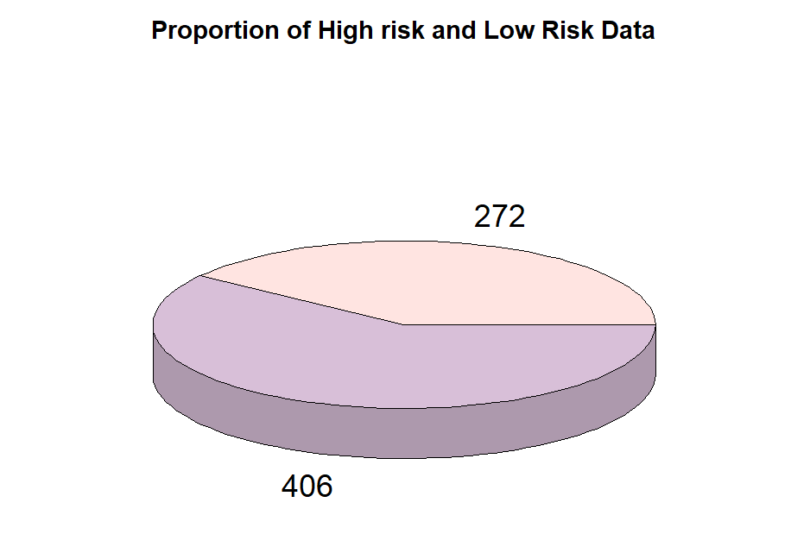
Descriptive Analysis
 | Age | SystolicBP | DiastolicBP | BS | BodyTemp | HeartRate
Min | 10.00 | 70.00 | 49.00 | 6.00 | 98.00 | 7.00
1st Qu. | 19.00 | 95.00 | 65.00 | 7.00 | 98.00 | 70.00
Median | 27.00 | 120.00 | 80.00 | 7.50 | 98.00 | 76.00
Mean | 30.62 | 113.20 | 77.56 | 9.19 | 98.58 | 74.36
3rd Qu. | 40.00 | 120.00 | 90.00 | 11.00 | 98.00 | 80.00
Max | 70.00 | 160.00 | 100.00 | 19.00 | 103.00 | 90.00
678 data into two categories, the low risk category (Y=0) totaling 272 data and the high risk category (Y=1) totaling 406 data

Slide 6
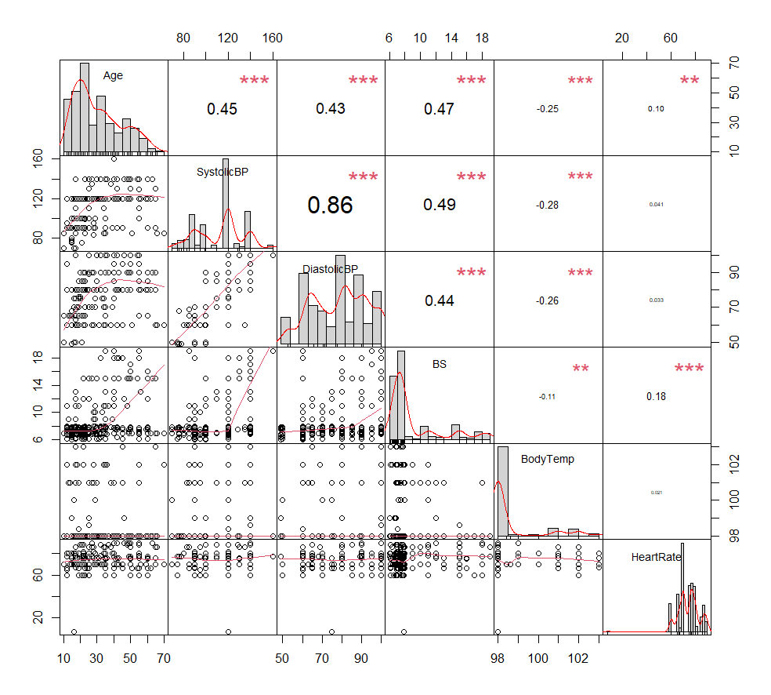
Descriptive Analysis
 | VIF
Age | 1.20572
SystolicBP | 3.92802
DiastolicBP | 3.7834
BS | 1.09247
BodyTemp | 1.69111
HeartRate | 1.02493
VIF for each variable is less than 10, so we don’t have multicollinearity in the data

Slide 7
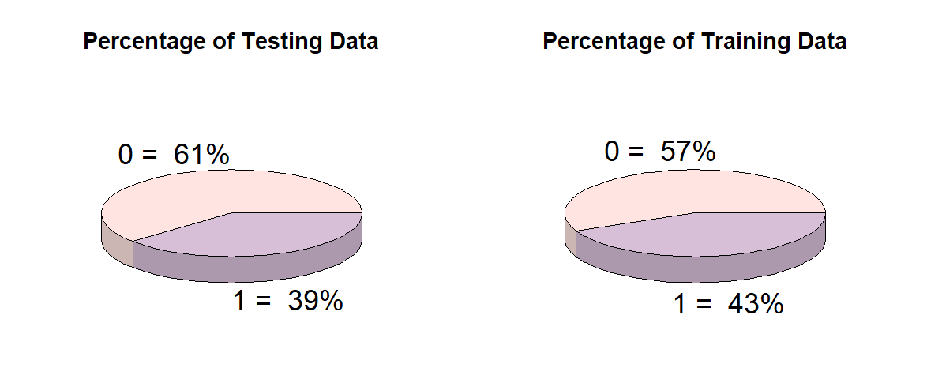
Training Data and Testing Data
Train |  | “Low Risk” | “High Risk”
 | 100% | 61% | 39%
 | 475 | 290 | 185
Test |  | “Low Risk” | “High Risk”
 | 100% | 57% | 43%
 | 203 | 116 | 87

Slide 8
Logistic Regression

Slide 9
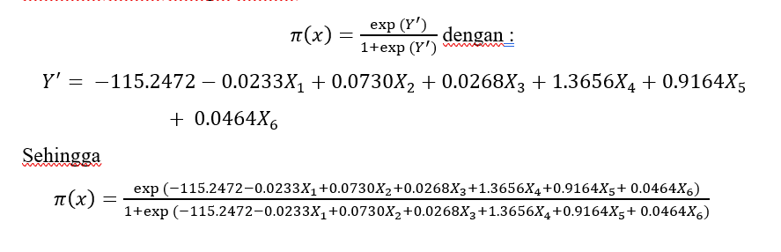
Logistic Regression Model
From the estimation value for each variable, we can built the logistic regression model
 | Estimate Std.
(Intercept) | -115.2472
X1 | -0.0233
X2 | 0.0730
X3 | 0.0268
X4 | 1.3656
X5 | 0.9164
X6 | 0.0464

Slide 10
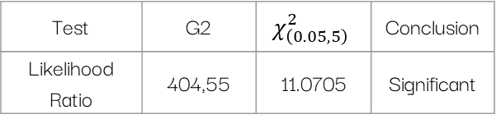
Simultaneous Model Test and Partial Test
Simultaneous Model Test
Partial Test
Parameter | Coefficient | Z | P-value | Conclusion
(Intercept) | -115.2472 | -7.715 | 1.21e-14 | Significant
X1 | -0.0233 | -1.415 | 0.1570 | Not Significant
X2 | 0.0730 | 3.699 | 0.0002 | Significant
X3 | 0.0268 | 1.041 | 0.2976 | Not Significant
X4 | 1.3656 | 5.867 | 4.43e-09 | Significant
X5 | 0.9164 | 6.734 | 1.65e-11 | Significant
X6 | 0.0464 | 2.076 | 0.0378 | Significant
Test | G2 | $$χ_{\left(0.05,5\right)}^{2}$$ | Conclusion
Likelihood Ratio | 404,55 | 11.0705 | Significant
Because G2 = 404,55 > χ²_{(0,05;5)} = 11.0705, so we can reject the null hypothesis and we can conclude the model is significant and also predictor variables simultaneously have effect for model.
Reject null hypothesis for each of X2, X4, X5, and X6 because the p-value < α and fail to reject null hypothesis for each X1 and X3 because the p-value > α, so we can conclude that each of X2, X4, X5, and X6 significantly have effect for model, but each of X1 and X3 don’t have.

Slide 11
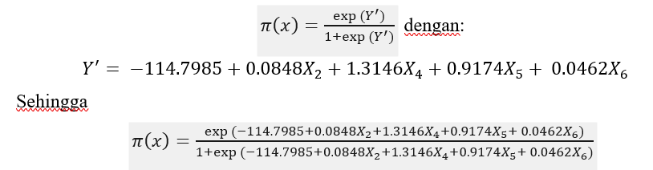
New Logistic Regression Model
 | Estimate Std.
(Intercept) | -114.7985
X2 | 0.0848
X4 | 1.3146
X5 | 0.9174
X6 | 0.0462
From the estimation value for each variable, we can built the new logistic regression model

Slide 12
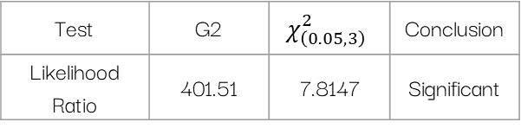
Simultaneous Model Test and Partial Test
Simultaneous Model Test
Partial Test
Parameter | Coeficient | Z | P-value | Conclusion
(Intercept) | -114.7985 | -7.652 | 1.98e-14 | Significant
X2 | 0.0848 | 6.536 | 6.30e-11 | Significant
X4 | 1.3146 | 5.713 | 1.11e-08 | Significant
X5 | 0.9174 | 6.714 | 1.90e-11 | Significant
X6 | 0.0462 | 2.031 | 0.0422 | Significant
Test | G2 | $$χ_{\left(0.05,3\right)}^{2}$$ | Conclusion
Likelihood Ratio | 401.51 | 7.8147 | Significant
Because G2 = 401.51 > χ²_{(0,05;3)} = 7.8147, so we can reject the null hypothesis and we can conclude the model is significant and also predictor variables simultaneously have effect for model.
Reject null hypothesis for each of X2, X4, X5, and X6 because the p-value < α, so we can conclude that each of X2, X4, X5, and X6 significantly have effect for model.

Slide 13

Coefficient of Determination and Odds Ratio
Coefficient of Determination
Odds Ratio
 | Odds Ratio
(Intercept) | 1.391974e-50
X2 | 1.0885
X4 | 3.7233
X5 | 2.5028
X6 | 1.0473
$$R^{2}$$
0.7743092
The coefficient of determination is 0.7743, meaning that 77.43% of the model variation can be explained by variable X2, X4, X5, and X6 and the remaining 22.57% is explained by other variables not in the model.
Odds ratio from X2 is 1.0885, indicates that if X2 increase by one unit, variable Y would 1.0885 times become high risk, if we are assuming all other variables are constant. And so on for the other variables

Slide 14
Accuracy, Sensitivity, and Specificity
Accuracy | Sensitivity | Specificity
0.8719 | 0.9304 | 0.7955
The model can predict 87.19% testing data accurately, the model can predict 93.04% high risk level of testing data accurately (conditioned on the individual truly with high risk level from all the prediction data which are predicted with high risk level), and the model can predict 79.55% low risk level of testing data accurately (conditioned on the individual truly with low risk level from all the prediction data which are predicted with low risk level).

Slide 15
Thanks!!

